Slide 1
Combine a Cable-Car with Hotel, Restaurants and Villas
Each Tower a Building with direct access to the Cable Car
Crowd investment of people they want to have one of the 350 Towers
Cable Car System for Lake Toba
The most effective mass transport system for a future oriented Eco-Tourism Destination:
Collecting the investment of 5 Trillion IDR in 3 month
Built 110 km cable car in 2 years
Never done before in the world
The world will look at Lake Toba
The best and most effective marketing itself

Slide 2
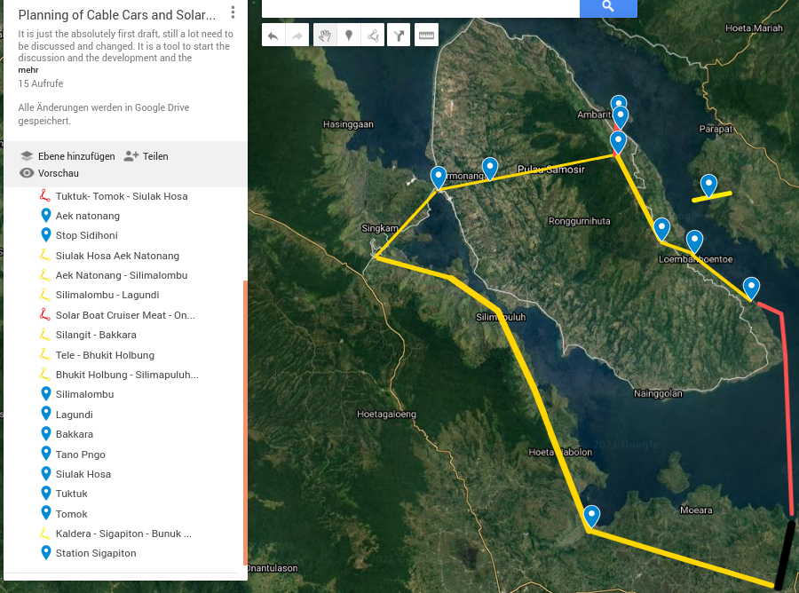

Slide 3
Why Cable Cars?
Cheap and fast to built
Specially perfect in areas with a lot of Erosion and mountains.
Energy efficient
Nearly noiseless
A touristic adventure itself
The safest transport system of the world
Multi porpuse:
  Tourists
  Local passenger
  Transport of goods

Slide 4
Government owned Company
The company can be owned by the Kapupaten of Samosir or by a several Kapupaten or by the BOPDT:
It has to be a company and it has to be effective orientated
It should be public owned, that not the financial interests of their owners are in front.
The company has to serve the interests of the citizen

Slide 5
The Investment
The Government can give a first financing to get an Administration and a planning done. This should be enough to run the planning activities for one year.
In the first three month after the founding the captital has to be aquired from the companies and people, they want to buy the right to be a tower.
It is planned to get out of selling the right to built a tower the whole cable car system can be financed.

Slide 6
The auction to sell the right of Building a tower
The cable car needs around 350 towers. This places are getting sold (maybe only for 99 years, if this is a selling not fit with the law) to private investors. They have to make a building which can carry on top the tower for the cable car. Each building must have a special high, what the cable car needs. On each building is an access to the cable car.
The auction must be well prepared with a good website, video presentation and all the benefits, which the investor has.

Slide 7
The preparation of the auction
A student group fromm the organization AMATI come to Silimalombu. They can prepare the auction in the next month.
Doppelmayr/Garavanta can make a first planning of the cable cars and where the towers have to be and which high they need at which place
The idea of the 110 km cable car at Lake Toba has to be published through all channels to get the investors hot to bid for the right.

Slide 8
The advantages for the investors
They have a direct access on the top of their building to a cable car to the international airport in Silangit.
The place is reachable for all the customers after the cable car is running very easy. It is nearly a guarantee, that each Business will running there.
They will be then in a centre of a new developing place. Around each tower a development will go on. Each tower is equipped a land of 2000 sqm ???around.
They get one cabin, which park on their house and they can design this cabin like they want. Scheduled bookings for the cabin can be made.
Each investor get 10 cards for lifetime usage of the cable car system.
They are getting member of the board of Supervisors for the cable car company.

Slide 9
The Land Aquiring
The cable car system is a public transport system. It has public interest. For this the government can take the land by paying the usual price per square meter
In this case the landowner don’t need to sell the land, if he himself want to built the tower under the same conditions like the investors. In this case, he has to declare this in between of 4 weeks, before the auction starts.

Slide 10
The advantages of the Landlords
They can built their own tower
When they give the land to Government, then:
  They have a cable car access point on their land.
  All the land of them is getting much more worthy
  With the money they got for their land, they will be able to built a house directly to the cable car tower themselve.
  They can develop their land around the tower. They can transport all their good with the cable car system to the place.

Slide 11
The running of the auction
The auction take place on a webpage in an interactive way. The people/companies have to register with their legal status and all getting all the time then further informations about the biding
The biding is running for 2 or 3 month. To get the biding started, the first 100 who give a biding get a lifetime free card for the usage of the cable car system.
In all media has to be reported all the time about the biding.

Slide 12
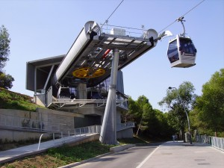
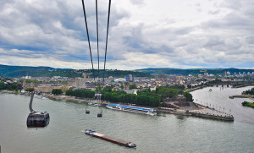
Which System?
There are especially two systems which are to use:
Mono-cable Gondola Detachable
(MGD)
One cable, which
hold the cabins and
move them.
Tri-cable Gondola Detachable
(TGD)
Two cable to carry
and one to move
the cabins.
Good Text: https://www.zatran.com/en/technolgie/seilbahn/

Slide 13
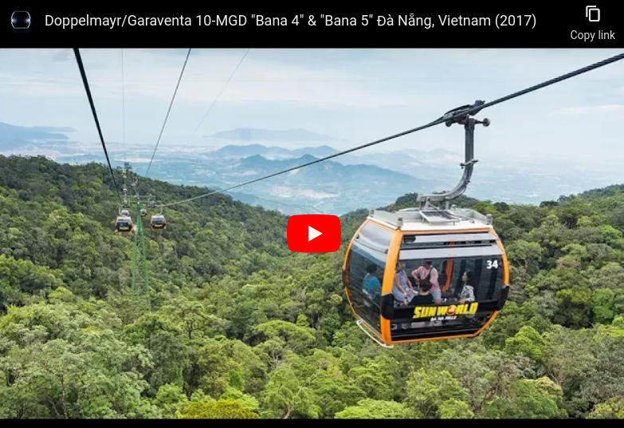
The Mono-cable Gondola Detachable (MGD)
The highlights:
  Speed up to 7m/s
  Transport capacities of up to 4,500 passengers
  per hour and direction
  Wide choice of cabin designs and options
  Functional cabin parking facilities to suit requirements
  Maximum availability
  Maintenance-friendly thanks to easy access to all components
  Cheaper to built
  Less space necessary for the stations
  More flexibility, more easy to change the Gondola with chairs or transport Gondola
  The Gondola are not so high over the ground (Less fear)
More Info at: https://www.doppelmayr.com/products/detachable-gondola-lift/
Click the picture

Slide 14
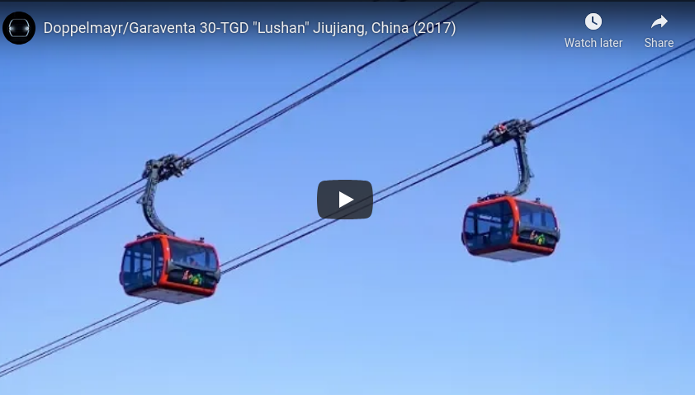
The Tri-cable Gondola Detachable (DTG)
The Highlights:
  Speed up to 8.5 m/s
  Transport capacity up to 5,500
  passengers per hour and direction
  Utmost availability
  Top comfort and safety
  Needs less wowers
  Can go high over the ground
  The cables can stay longer and needs less energy
  Impressive Construction for a touristic highlight
More Information: https://www.doppelmayr.com/products/3s-gondola-lift/
Click for the video

Slide 15
Points to discuss
The TDG will be a touristic highlight. It is most modern system and the most powerful.
The speed and the transport capacity of the MDG is only less then 20 % lower, but it will be much cheaper and it is more easy to make stations in between.
For a whole cable-car system around Lake Toba it is better, just to have one system. It is then more easy to maintenance. The training of the operators is more easy and also to keep the spare-parts.
But for the cable-car from Silangit to Meat and from Tomok to Siulakhosa maybe the TDG is more impressive for the Marketing.

Slide 16
To create a big thing, never done in the world
Each of the 350 Towers of the Cable Car System is getting a hotel or Restaurant or Villa or Lapo Tuak or……
The right to built the tower is getting sold to the investors. They have to built it in a fixed time and with the standards which the Cable Car needs
One cabin belongs to the building and this stop at each turnaround on the roof.
All 107 km of Cablecars are getting built in one year
The Tourism starts then directly with full power!

Slide 17
Built in a Privat Public Partnership
To develop Lake Toba as a touristic ecologic hotspot it needs a sustainable transport system.
Because Cable- cars are efficient to operate it is cheaper than roads. Also for the user it is more comfortable and they will pay for it. The investments in roads and parking spaces can go from the Government to buy shares from the to founding PT. LakeTobaTransport.
The PT.LTT has been structured as a Business and Investment case. It will be a shareholder company, where only people, they are connected to the area, can buy shares. They have to live at Lake Toba or their origin is from there. The profit will be limited, the rest has to stay in the company for further investments.

Slide 18
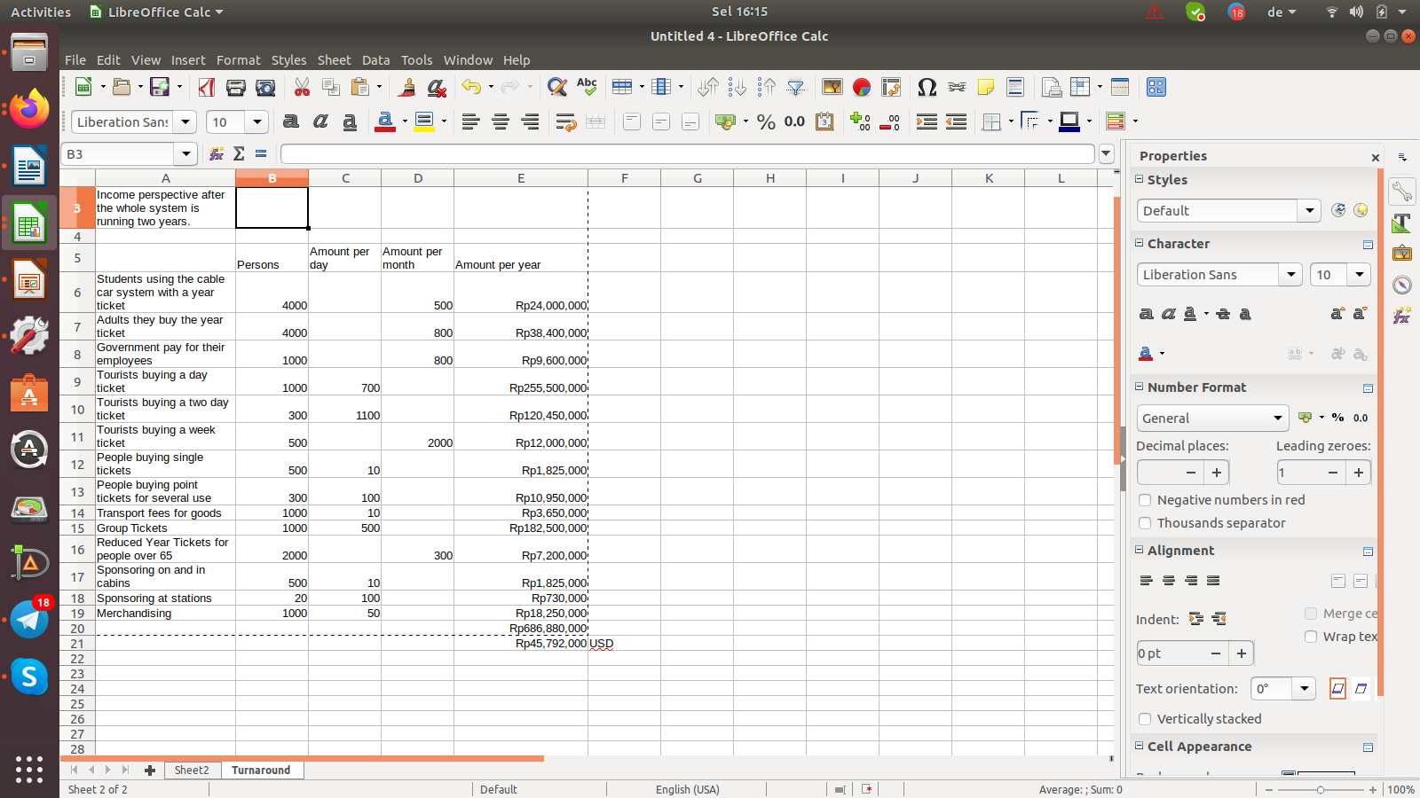
Turnaround of the PT.LTT
Just a absolutely first planning.
We go for a pricing which is adapted from the skiing areas.
A lot of locals will use the cable car system each day. Especially students and employees, they have to go to work or school.
The most tourists from Jakarta will buy then the daily tickets. We just go for numbers, what we think, what will be after the whole system is running.
In the calculation the last three 000 are cut. We think a turnaround of 700 Billion Rp is possible.

Slide 19
Costs of Installation the Cable Car system
It is difficult to give here numbers. The TGD system is arround 2,5 times more expensive then the MGD. There is a good article about this theme from Makkah. It also show that the return of Investment take by MGD take around 6 years and for an TGD over 20 years.
The costs to built the 110 km MGD will be at least 5 Trillion Rp. The costs can be reduced, when the towers and the cabins are getting produced in a local workshop.
Or the towers are getting Buildings and getting sold.

Slide 20
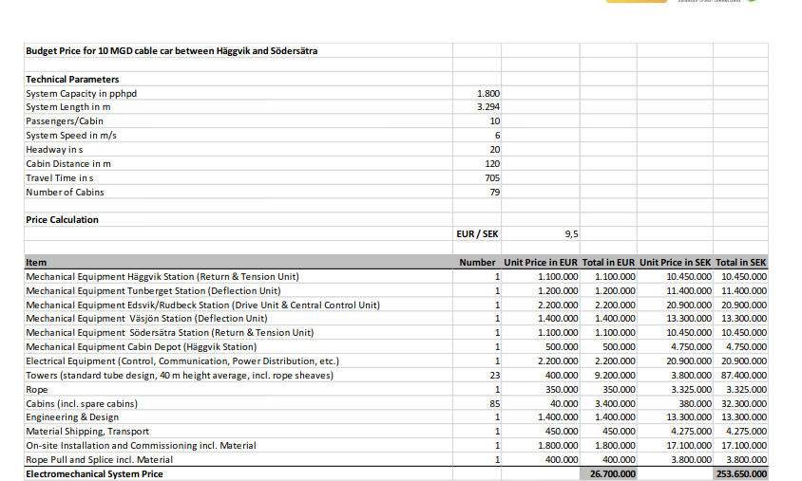
Cost details for the Equipment
Here are some cost details from a Project in Sweden to built an MGD with 3,3 km. Exactly it can be seen, that the highest costs are for the cabins and Towers.

Slide 21
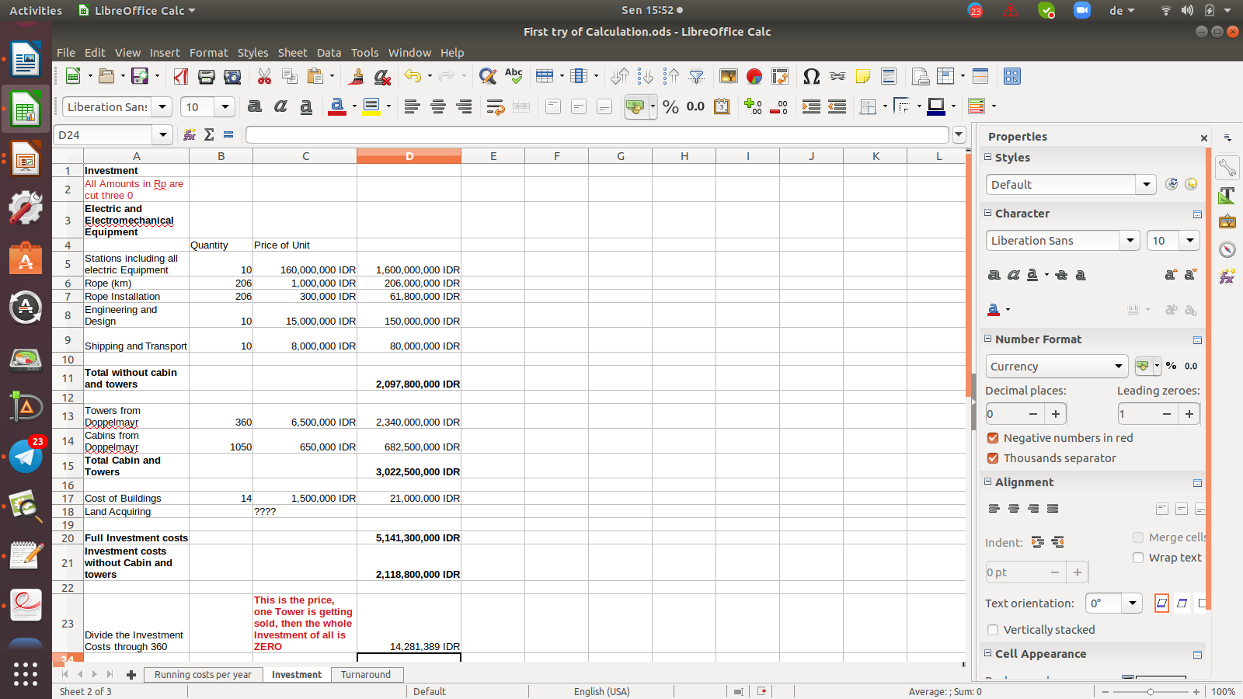
Try of Calculation of the Investment costs
We took here the prices from the project of Schweden from 2017.
Not included are the costs for the Land.
It is just a calculation to get numbers. Just to get on a way to a due diligence.
The cost of all will be around 5 Trillion Rp.
It can be reduced to Zero, when one Building is getting sold for 14 Billion

Slide 22
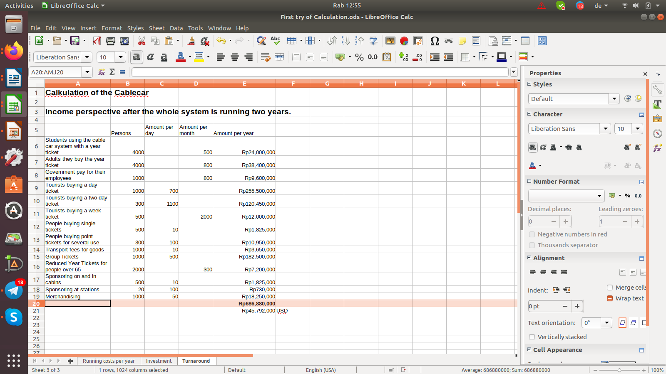
Turnarround
We try to think to get numbers and prices for the customer.
For the locals they buy the year ticket we assume, that they will buy the ticket, because otherwise they have to stay for work or school in Pangururan. This they will save, if they use the cable car
For the prices for the tourists we take around 60 %, what they would spend in Europe for a service like this.
The turnaround we get out here is 686 Billion/year

Slide 23
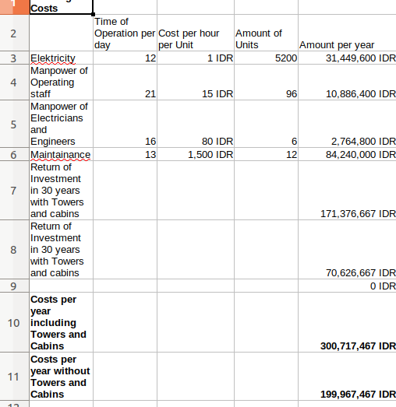
Running costs
Even everything is getting bought from Doppelmayr, still the revenue is higher then the costs.
Even this calculation is 50 % wrong.
This can be.
It is just a first draft for discussion to see, if it is possible.

